Slide 1

GPM Forum
Mensa in Space
January 11, 2025

Slide 2
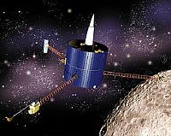
Or…Doing It is
Half the Fun
By Don Doerres,
Retired Rocket Scientist
Writer
Mensan Since 1976

Slide 3
Can I Get the Slides?
Yes
https://github.com/dondoerres/2025_GPM_by_DRD

Slide 4
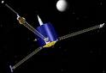

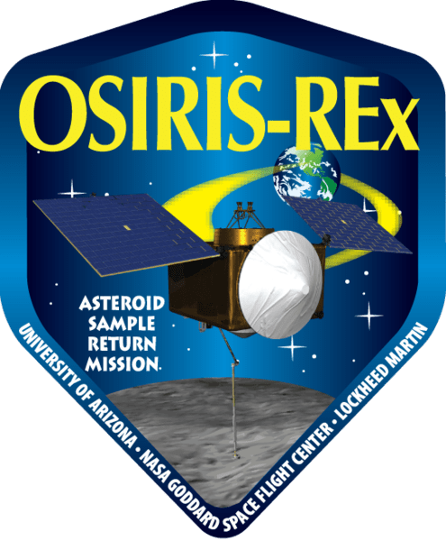
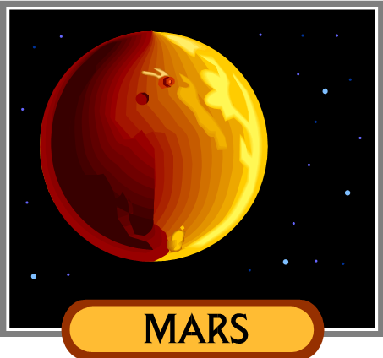

Donald R. Doerres, II
University of Iowa, BSEE 1973
Distinguished Member of the Academy of
The College of Engineering
don@azlaborlaw.com

Slide 5

…Book Flog!
The first adventure of
Patricia Boffin is available
from Amazon in
Kindle and Paperback

Slide 6
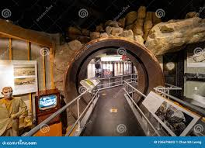

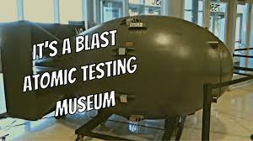
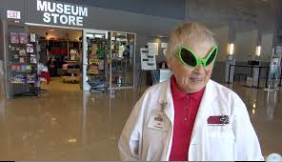
Tales from the Test Site

Slide 7


First Contact – Life Elsewhere
Originally presented March 15, 2018 to
BIS 402 : LIFE BEYOND EARTH

Slide 8
FUN WITH LUNAR PROSPECTOR…
© 2025 Don Doerres

Slide 9
What Was Lunar Prospector?
A Little Spacecraft with Attitude
Part of NASA’s Discovery Program
Well Thought Out, Limited Mission
Exemplified Epitome of Faster, Better, Cheaper

Slide 10
Still Crazy After All These Years
A brief history of the mission
A description of the mission
A description of my involvement

Slide 11
A Brief History Part 1
Gerard O’Neill of the Space Studies Institute (SSI) wrote an article in the early 1980’s about space exploration and the hope of finding ice on the moon
At this time NASA was considering unmanned missions to the moon with billion-dollar spacecraft.
O’Neill said “we wanted the moped of space probes”

Slide 12
A Brief History Part 2
1985 the SSI commissioned a study by James French of JPL to see just what a moped satellite could be
The result of this study was a concept for a $50 million dollar mission carrying just one instrument, a spare gamma-ray spectrometer left over from Apollo days

Slide 13
A Brief History Part 3
NASA was interested in BIG missions at this time
Big missions, Big money
Many scientists
Small missions were ignored by NASA
At least one private group tried to raise the funds commercially for a moon mission, including Dr. Alan Binder’s Lunar Research Institute, about 1988

Slide 14
A Brief History Part 4
Then came such failures as Mars Observer MOC -- Lost, August 1993
$1,000,000,000 loss…

Slide 15
A Brief History Part 5
How about a New Plan?
Instead of huge spacecraft that do a little of everything – let’s have:
Small spacecraft that do a few things well
Lose one bird, don’t lose the whole mission
Dr. Binder has one…

Slide 16
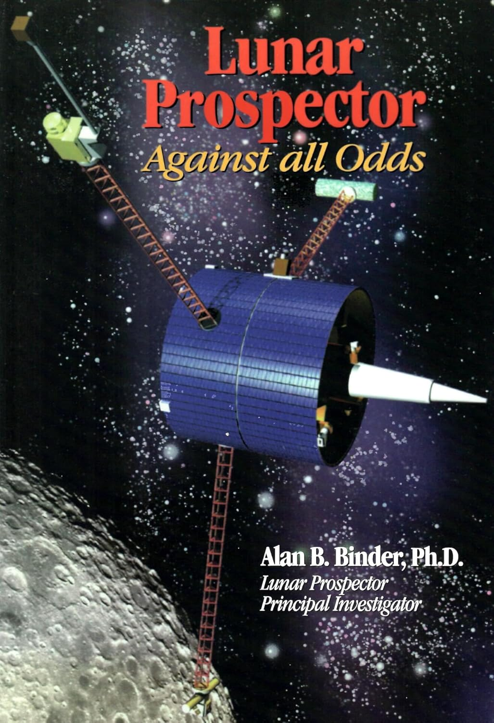
Alan B. Binder, Ph.D.
https://www.amazon.com/Lunar-Prospector-Against-All-Odds/dp/1928771319
Book not for the faint of heart
Dr. Binder tells all in 1181 pages

Slide 17
Discovery Program!
The primary goal of NASA's Discovery program is to conduct a series of frequent, highly focused, cost-effective missions to answer critical questions in solar system science. Formally started in NASA's FY 1994 budget, the Discovery program features small planetary exploration spacecraft with focused science goals that can be built in 36 months or less, for less than $190 million in development costs and a total mission cost of less than $299 million.
The program encourages the use of new technologies, transfer of these technologies to the private sector, increased participation of small and disadvantaged businesses, the pursuit of innovative ways of doing business, and support of the nation's educational initiatives. The objective is to perform high-quality scientific investigations which will assure continuity in the U.S. solar system exploration program and enhance general public awareness of, and appreciation for, solar system exploration.

Slide 18
Lunar Prospector
Six experiments
Gamma Ray Spectrometer
Neutron Spectrometer
Magnetometer
Electron Reflectometer
Alpha Particle Spectrometer
Doppler Gravity Experiment

Slide 19
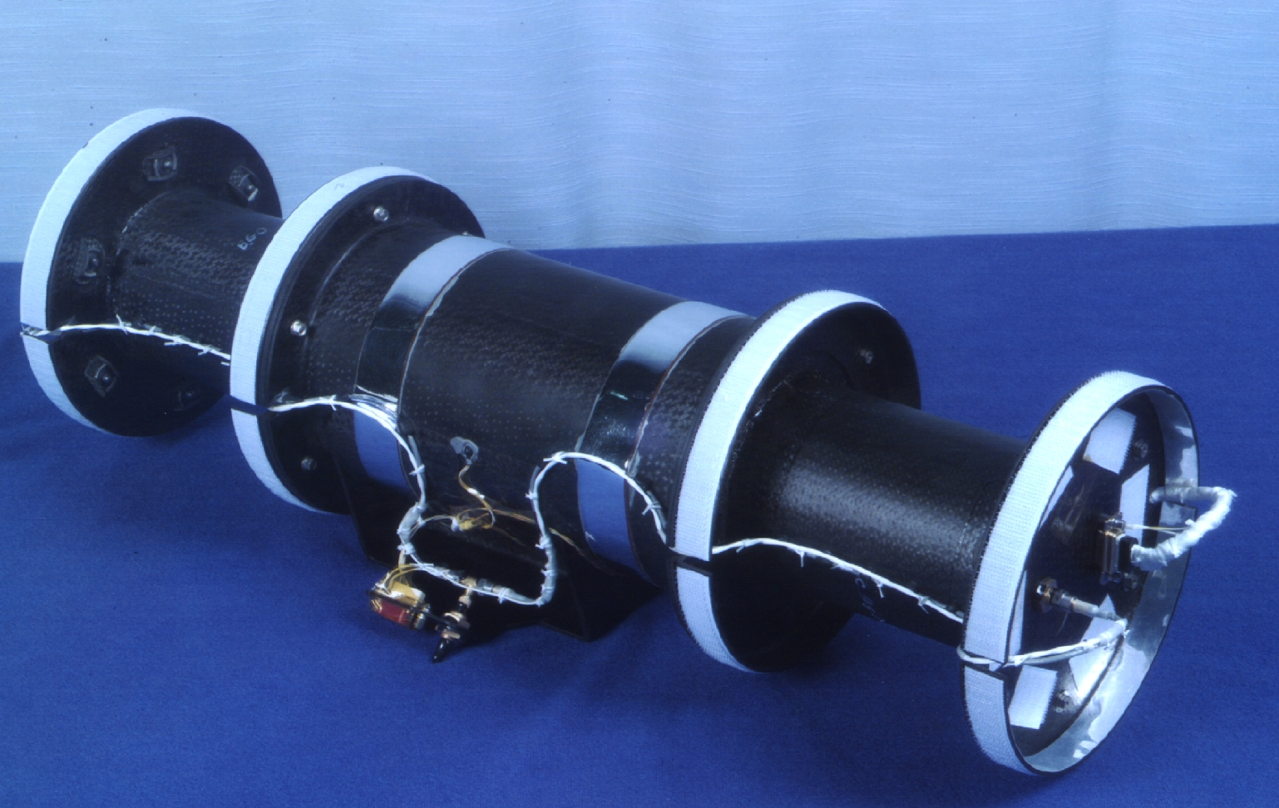
Lunar Prospector
Gamma Ray Spectrometer
Sensitive to: thorium (Th), potassium (K), uranium (U), iron (Fe), Oxygen (O), silicon (Si), aluminum (Al), calcium, Ca), magnesium (Mg), and titanium (Ti).
Especially sensitive to the heavy, radioactive element thorium and the light element potassium.

Slide 20
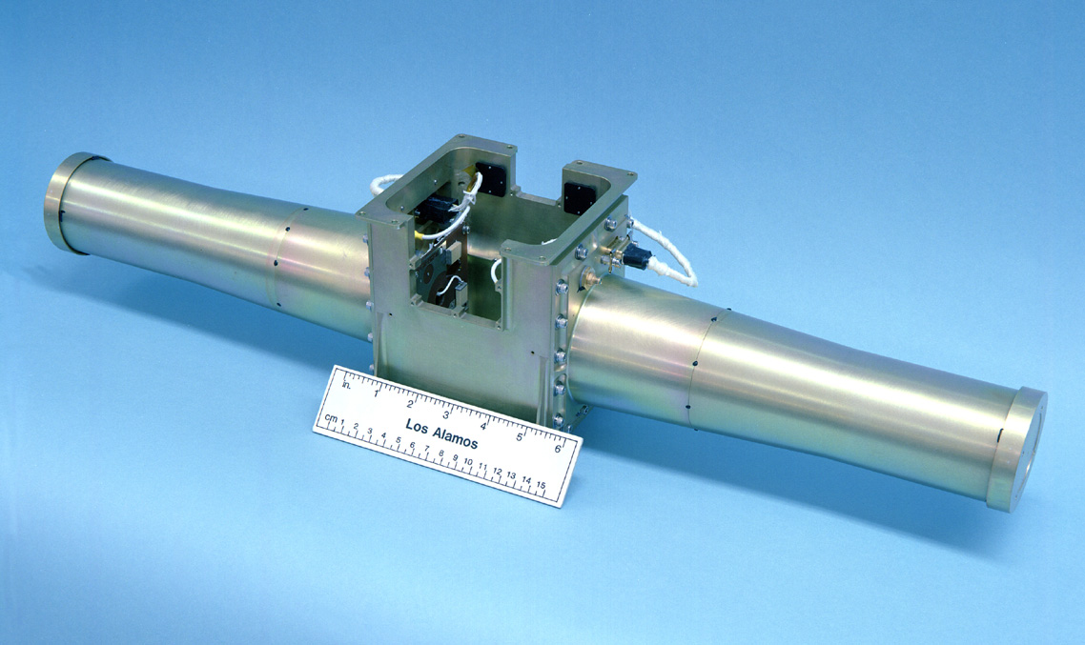
Lunar Prospector
Neutron Spectrometer
Worked by detecting hydrogen indirectly by finding neutrons
Prime mission was to find water, which is indicated by hydrogen

Slide 21
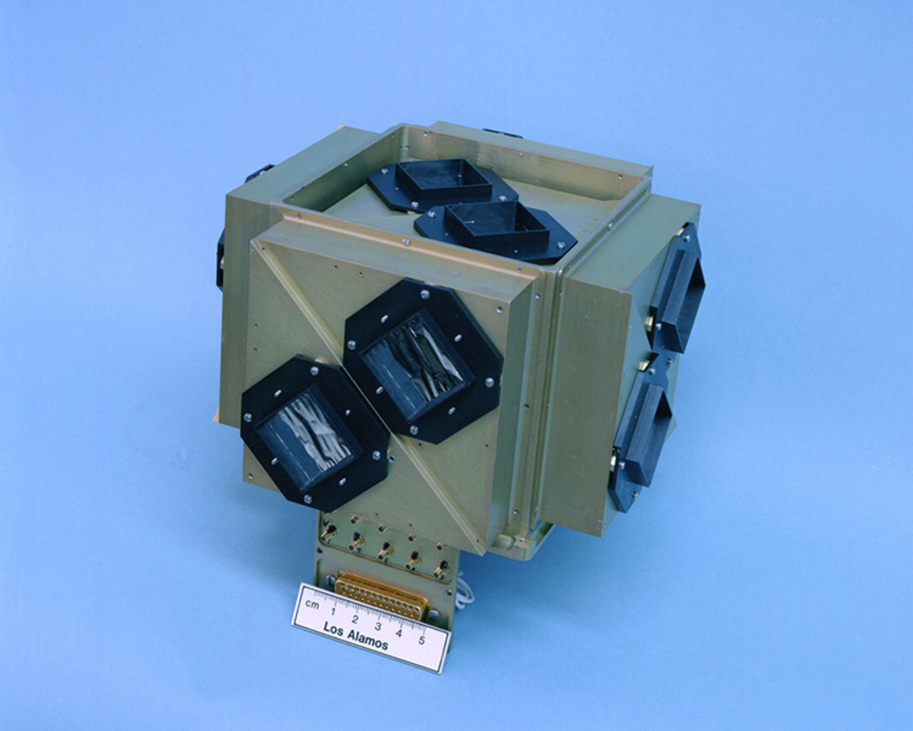
Lunar Prospector
Alpha Particle Spectrometer
Detected outgassing events on the lunar surface by detecting alpha particles from radon gas and its decay products

Slide 22
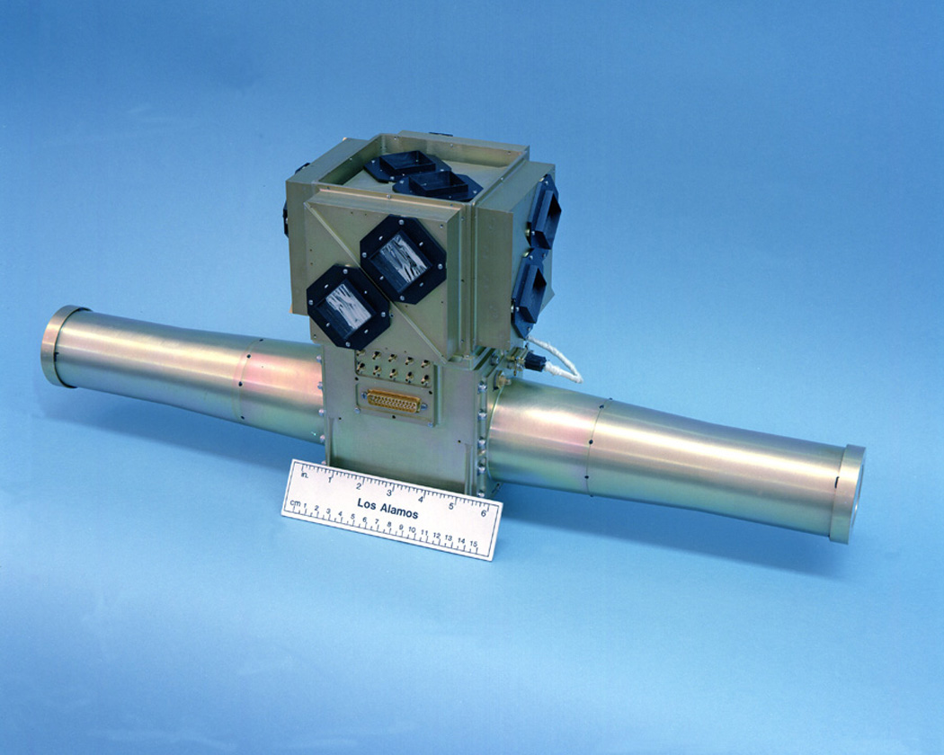
Lunar Prospector
Alpha Particle Spectrometer
and Neutron Spectrometer mounted together

Slide 23
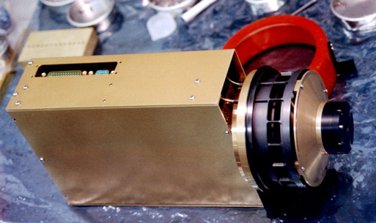
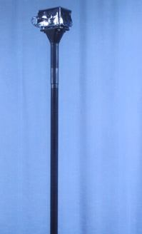
Lunar Prospector
Electron
Reflectormeter
Magnetometer
Returned data on the lunar crustal magnetic field and the lunar induced magnetic dipole; mapped localized magnetic fields

Slide 24
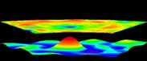
Lunar Prospector
Doppler Gravity Experiment
Used doppler tracking of the S-Band radio signals broadcast from the spacecraft (actually, the telemetry signal from the spacecraft) to characterize the orbit of the spacecraft and the lunar gravity field

Slide 25
Where I Come In…
In 1996 Spectrum Astro was awarded the Command and Data Handling (C&DH) contract for Lunar Prospector from Lockheed/Martin, the Prime Contractor
I was responsible for all software development for the C&DH and for key parts of HW/SW partitioning

Slide 26
Let’s Have Some Fun…
The “standard approach” Costs Too Much
What are the alternatives?

Slide 27
Let’s Have Some More Fun…
Instead of a large team, how about a tight knit, small group with one person in charge of each key activity?
What do we have we can already use?

Slide 28
Hardware Software Partitioning
Software is good at:
Complicated Sequences
Doing things up to a moderate rate of speed
Doing integer math
Hardware is good at:
Simple Sequences
Doing very simple things very fast
Doing simple logic (and, or, negate…)

Slide 29
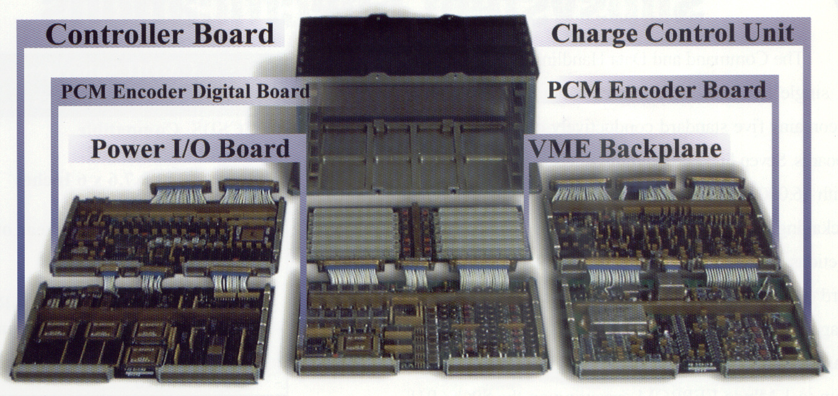
Lunar Prospector C&DH

Slide 30
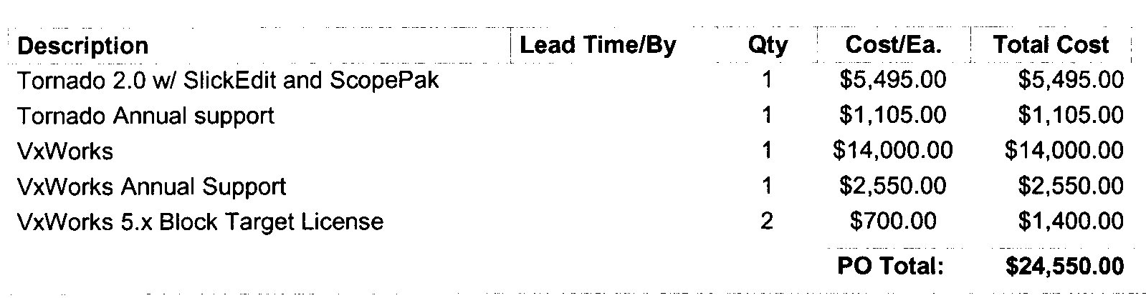
Software Tool Cost-RTOS

Slide 31

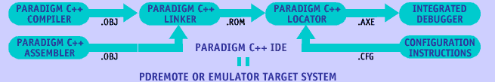
Software Tool Cost-RTOS
$995.00 complete.
Unlimited target licenses.

Slide 32
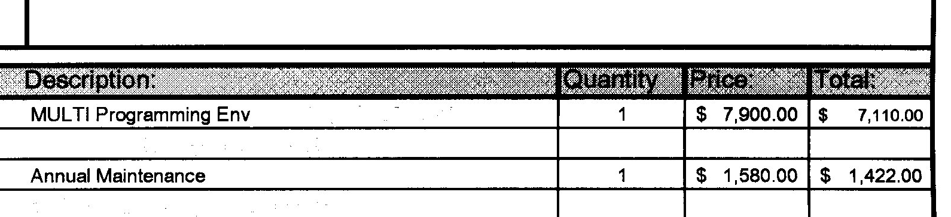
Software Tool Cost-Compiler

Slide 33
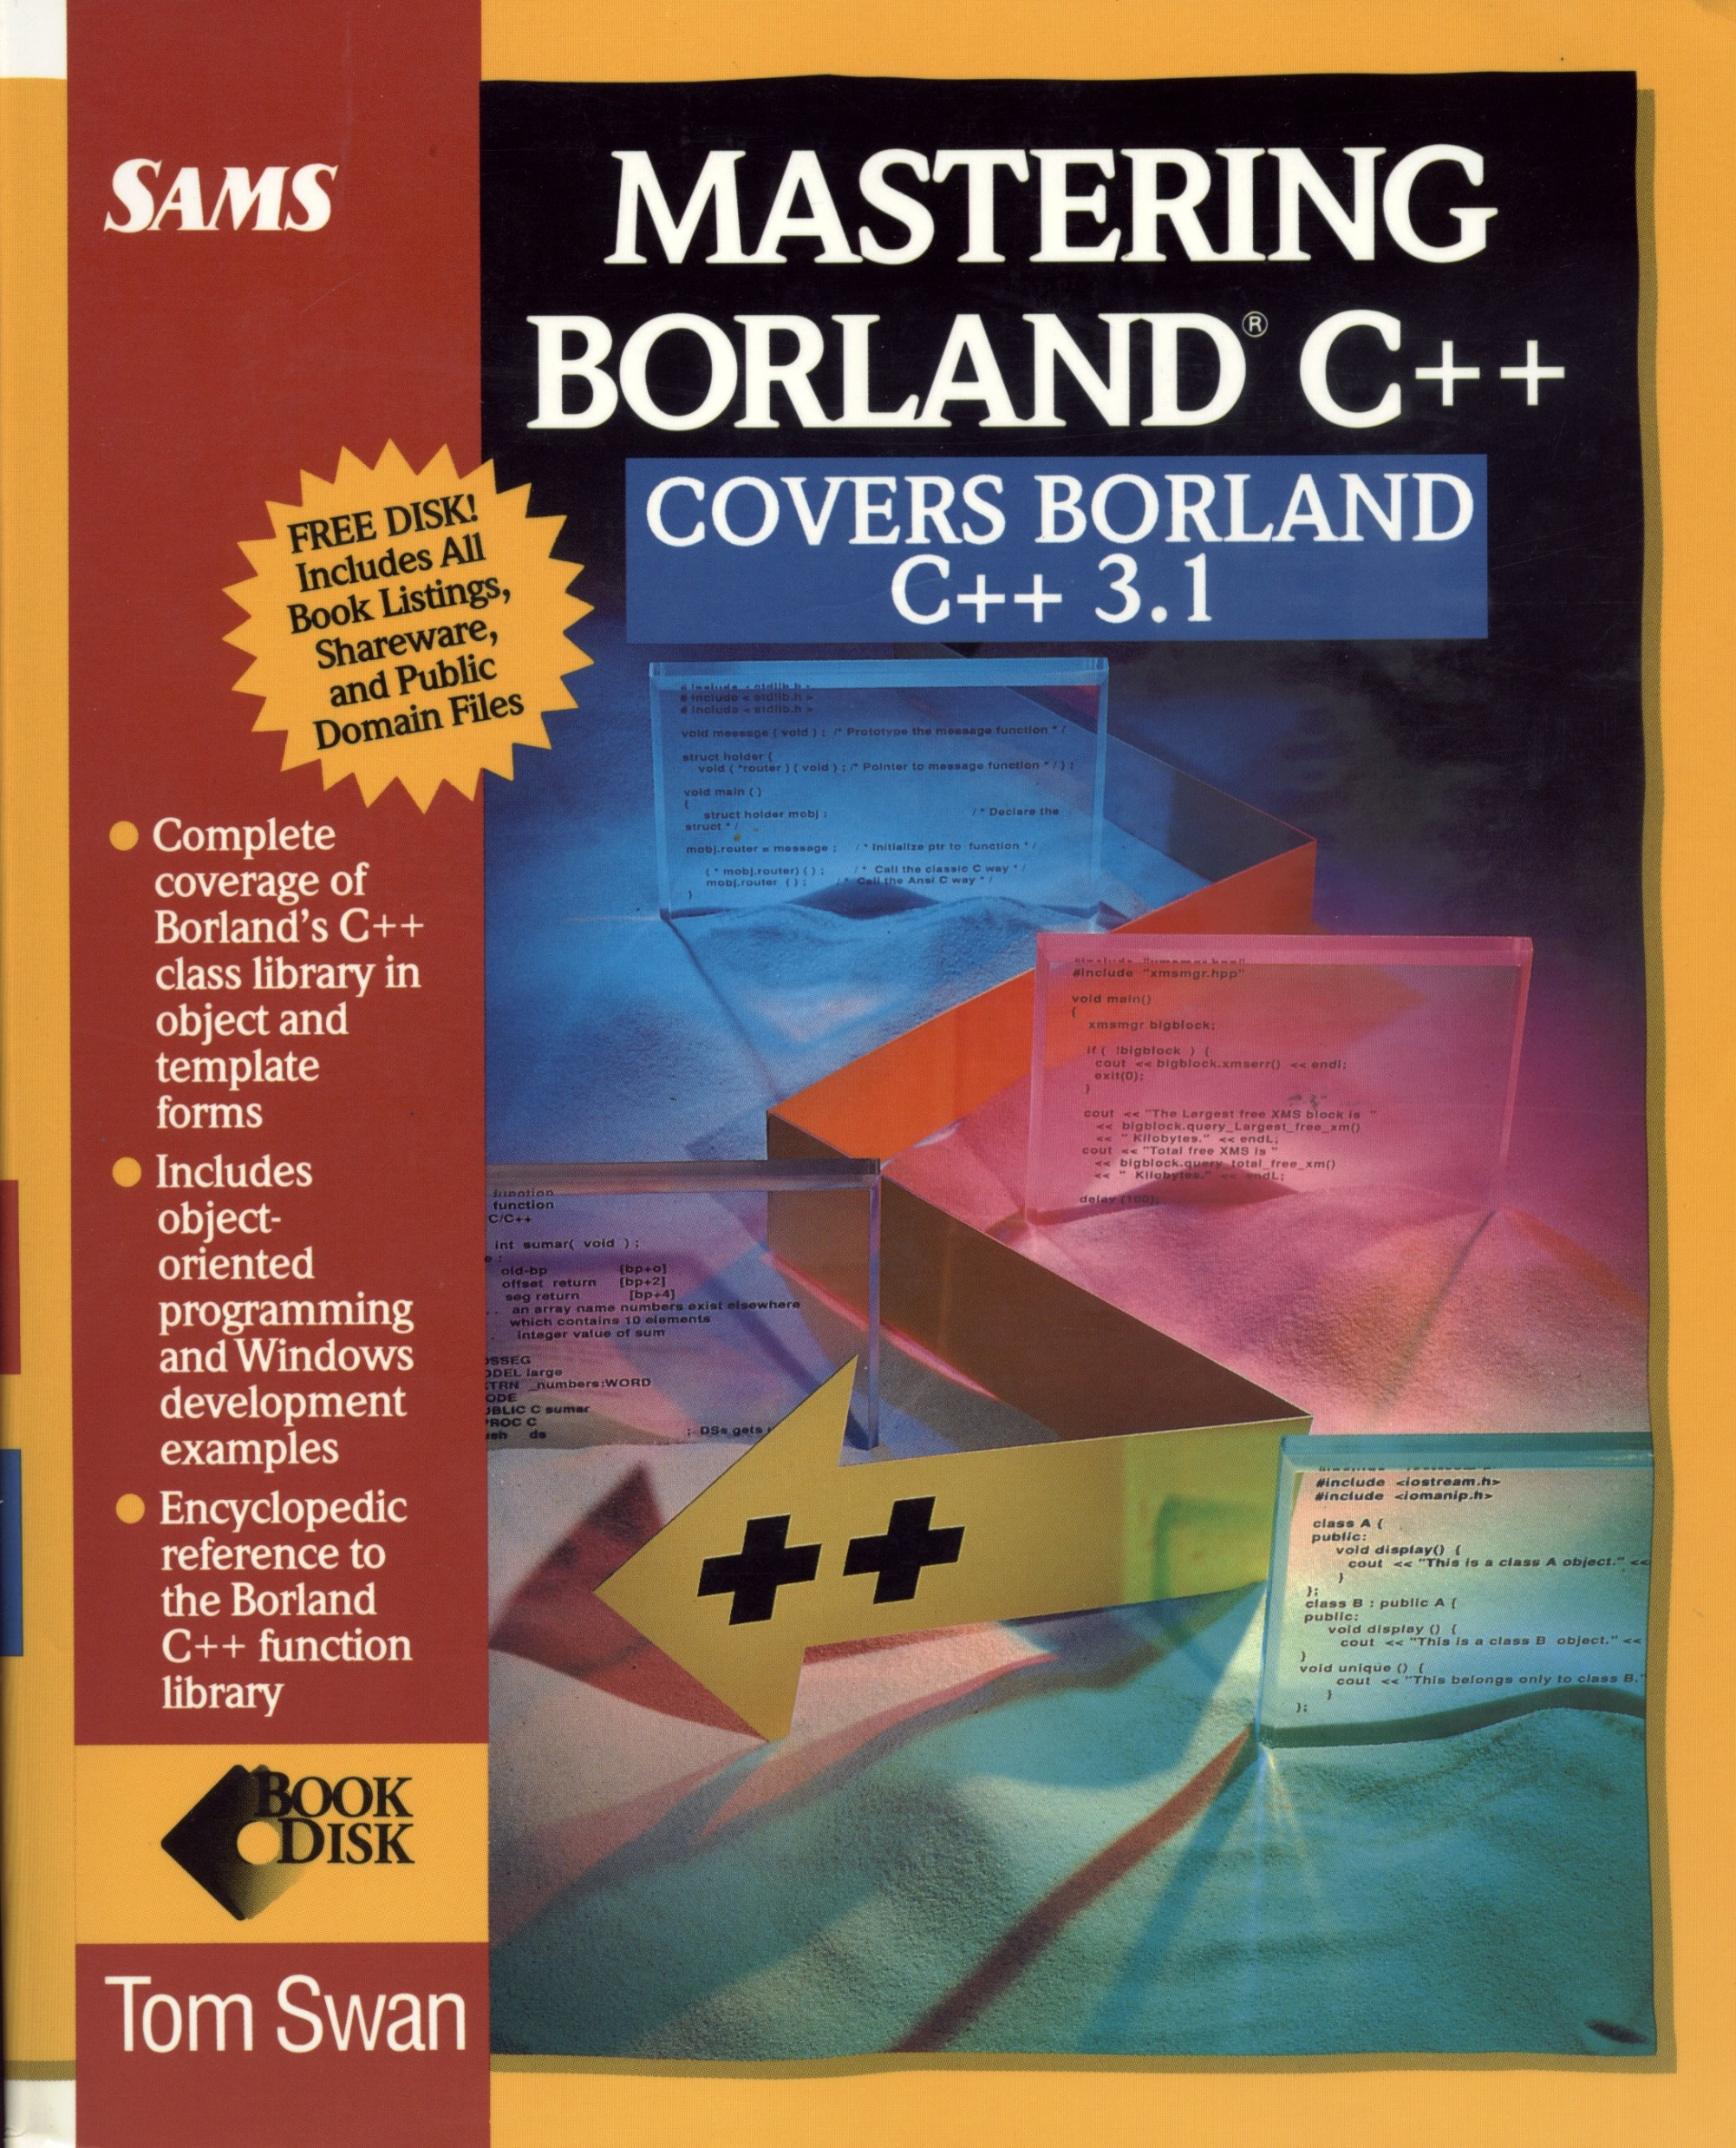

Software Tool Cost-Compiler
$39.95 …plus $5 shipping and handling
$39.95 plus $5 shipping &
handling!

Slide 34
The Software
1783 lines of ‘C’ in 11 months.
One byte of included assembler: 8086 IRET instruction for unassigned interrupts

Slide 35
The Software
No libraries included (no stdio.h, no stdlib.h, no math.h…nothing but raw C!)
All integer (16 bit) math
Seventeen ‘.C’ source files, one ‘.asm’ file

Slide 36
The Software
Usual start up code
CPU wake up
Hunt for console input
Jump to flight code
High level startup
Set up CPU interrupts
Initialize globals
Setup VME I/O space
Setup hardware circular queue
Run forever loop

Slide 37
The Software
Command handling
CCSDS
Fixed length commands
Verify on ground, then Execute
Telemetry
CPU built frames
Data stuffed into a FIFO for downlink—FIFO 4 words deep

Slide 38
Software Results
No anomalies
No reboots
No VME bus errors
Few Operational problems
Commanding in low Signal/Noise due to moon bounce
“Engineering mode” (default and diagnostic mode) never used in flight— experimenters later said they would have preferred to never include it since mission was so flawless

Slide 39
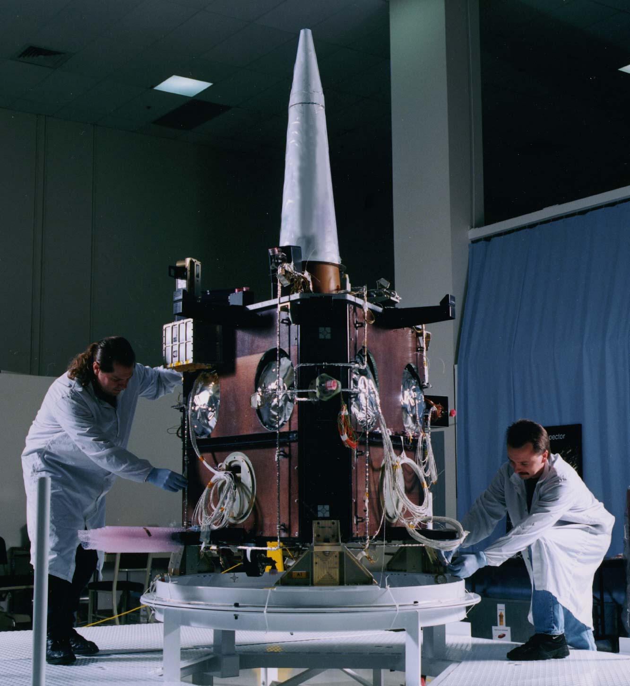
Building It Up

Slide 40
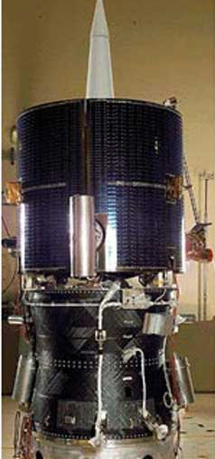
Mounted on Kick Motor

Slide 41
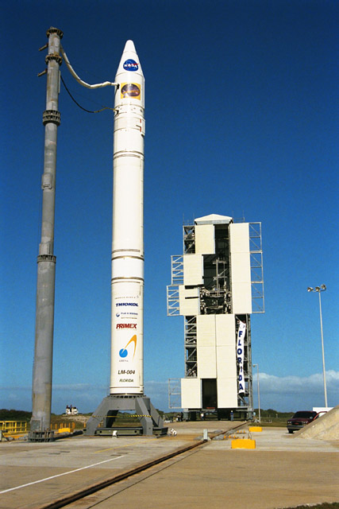
Ready…

Slide 42
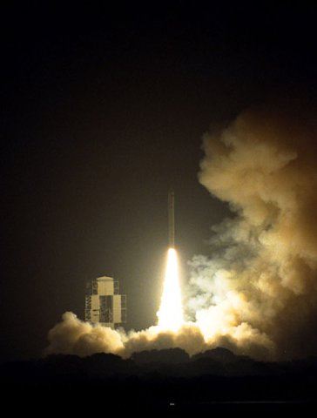
Go!

Slide 43
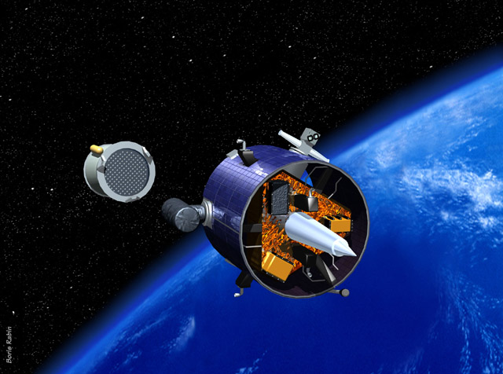
Separation…

Slide 44
In Orbit

Slide 45

Length of Mission
Actual
Anticipated

Slide 46
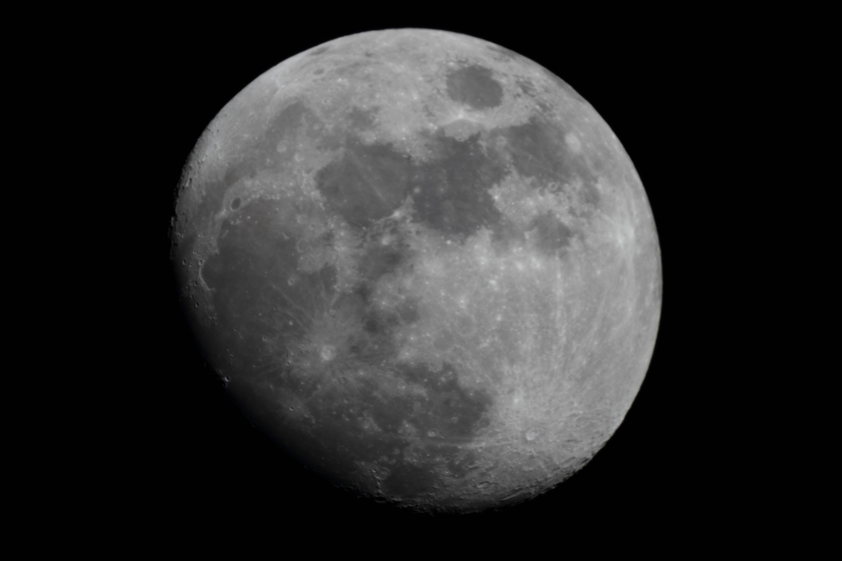

RIP Lunar Prospector

Slide 47
Favorite Lunar Links
http://nssdc.gsfc.nasa.gov/planetary/discovery.html
https://nssdc.gsfc.nasa.gov/nmc/spacecraft/display.action?id=1998-001A
https://science.nasa.gov/mission/lunar-prospector/
https://en.wikipedia.org/wiki/Lunar_Prospector

Slide 48

MY VIEWPOINT
 There’s gotta be somebody out there
 I’m still waiting…and watching
 Isaac Asimov’s Foundation doesn’t have
anybody out there
 All seven books of the Foundation Trilogy put humans in an almost empty universe -- for our own good, of course
 I really prefer lots of friendly aliens – and these we have, at least in imagination

Slide 49
ENGINEERS AND SCIENTISTS
Engineers
 What and how questions
 Work for the material benefit of humanity
Scientists
 Why questions
 Work to understand the world we live in
Most mad scientists are really mad engineers
Scientists and Engineers often swap roles
 Applied science
 Research engineer

Slide 50
THREE POINTS IN 20 MINUTES
Earth’s first space man
A different view of Drake’s Equation
Outreach to aliens – Deep Space 1

Slide 51
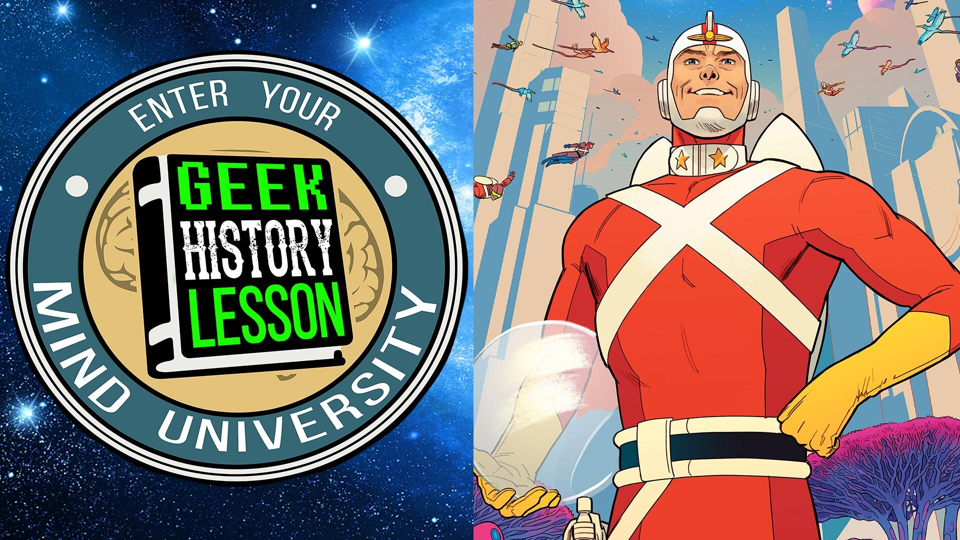
EARTH’S FIRST SPACE MAN
Fair Use for Educational Purposes claimed
 Adam Strange, of course:
https://www.geekhistorylesson.com/episodes/ghl-311-adam-strange-with-tom-king-mitch-gerads-amp-doc-shaner

Slide 52
DRAKE’S EQUATION
N = R X FP X NE X FL X FI X FC X FL
 N = number of alien civilizations in (i.e., across) the Milky Way
 R = number of stars in (i.e., through) our galaxy
 fp = Fraction of stars with planets
 ne = number of planets where life as we know it can exist
 fl = % of those planets where life arises
 fi = % of those planets (fl) where intelligence develops
 fc = % of those societies that develop electromagnetic science
 fL = % of societies that emit electromagnetic signals into space for a long time
Note: Dr. Drake (1930-2022) was a professor at UC Santa Cruz.

Slide 53

DRAKE’S EQUATION AS YOU HAVEN’T SEEN IT
 E = I * R
The generic relationship between a through and an across variable where:
E = generic across variable I = generic through variable
R is a constant of proportionality

Slide 54

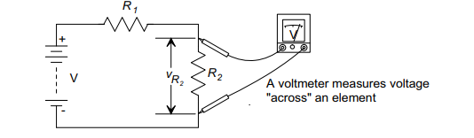
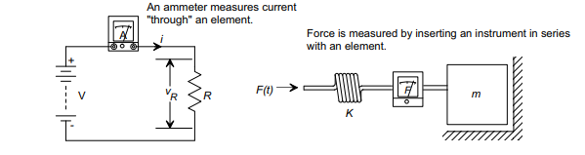
ACROSS AND THROUGH

Slide 55
THROUGH AND ACROSS VARIABLES
 Through variable has value transmitted through an element
 Across variable value is determined by measuring a difference of the values at two extreme points of an element
 Through and Across variables are related by a Constant of Proportionality

Slide 56
EXAMPLES FROM “REAL LIFE”
 Pressure equals density times height
 P = H * D
 Water pressure increases the deeper you go
 Force equals displacement times a constant
 F = K * X
 Amount of force required to stretch a spring is a constant times the amount you stretch it
 Force equals mass times acceleration
 F = M * A
 Pulling “G’s” when you accelerate your car

Slide 57


A LITTLE MATH RAZAMATAZ
 N = R * fp * ne * fl * fi * fc * fl
 Let N = E, the across variable
 Let R = I, the through variable
 Let the proportionality constant be
fp * ne * fl * fi * fc * fl = R
 Substituting:
 E = I * R
 The point is...just see what we can do with simple math

Slide 58

SIMPLE MATH
 E=IR
 I=E/R
 R=E/I
 P = E*I or the product of the through and across is “power” in physics.
 What might “Power” mean with respect to inhabitable planets?
 Is “The Force” real?

Slide 59

FUN WITH FIGURES
 Given N:
 How many intelligent species have been in television shows that are long running?
 How many species are intelligent?
 Just how many stars are there in the galaxy(ies)?
 If I know the through variable, then I can figure the across variable by algebra.

Slide 60
A REAL OPPORTUNITY TO SEE THE FUTURE
 Usually, we can only guess
 This is a rare occasion when you can see the future from a point in the past
Ready?

Slide 61

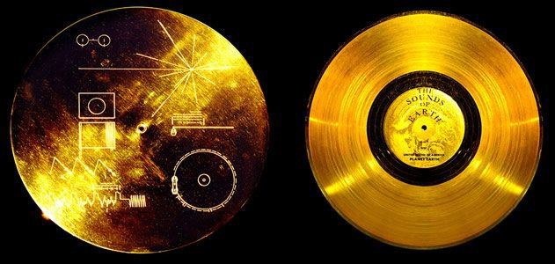
OUTREACH
 Most spacecraft carry a greeting from earth
 Consider the gold record on Voyager I and II
Fair Use for Educational Purposes claimed
 All of the infrared spectrometers from the ASU SESE carry a plaque with the signatures of everyone on the project
NOTE: My name is out there!

Slide 62

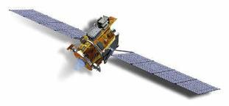
THE DEEP SPACE 1 CD
 Certainly less publicized than the Voyager record
 The spacecraft actually carried three or four different CD’s and DVD’s literally sewn into the thermal blanketing.
 These were from various groups associated with the project
Image courtesy NASA

Slide 63

THE DS1 CD
I was responsible for putting together a CD from the prime spacecraft contractor, a company called Spectrum Astro (later General Dynamics C4, later General Dynamics IS, later Orbital Sciences, later Orbital ATK, later Northrup Grumman…)

Slide 64

MORE DS1 CD
 The DS1 contained comments from anyone on the mission interested in making them
 Young people from Boys and Girls Clubs all over the world were invited to convey in pictures and words what they thought the future would bring.
 The pictures are 27 years old now.

Slide 65
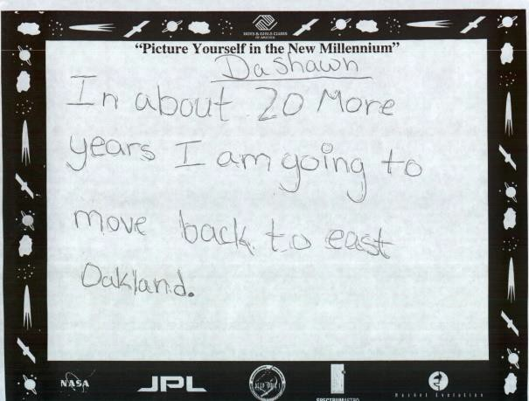
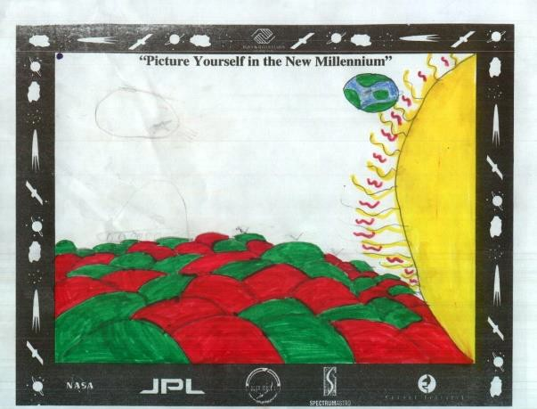
WHAT CAN YOU DO WITH THE DS1 CD?
 First, get one:
https://www.slideshare.net/dondoerres
https://github.com/dondoerres/DS1_CD
 Then reflect:
 What was the vision of the future 27 years ago?
 Hundreds of young people shared their vision by sending it into deep space.
 Have a look…

Slide 66
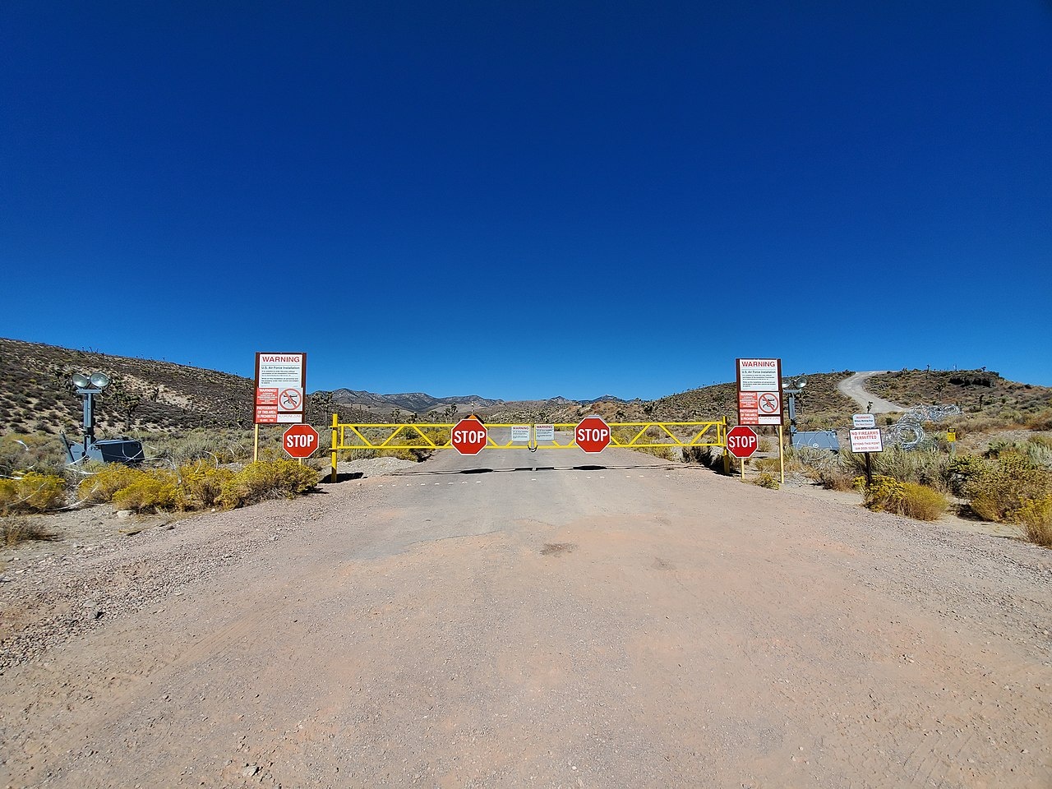
The Truth is Out There

Slide 67
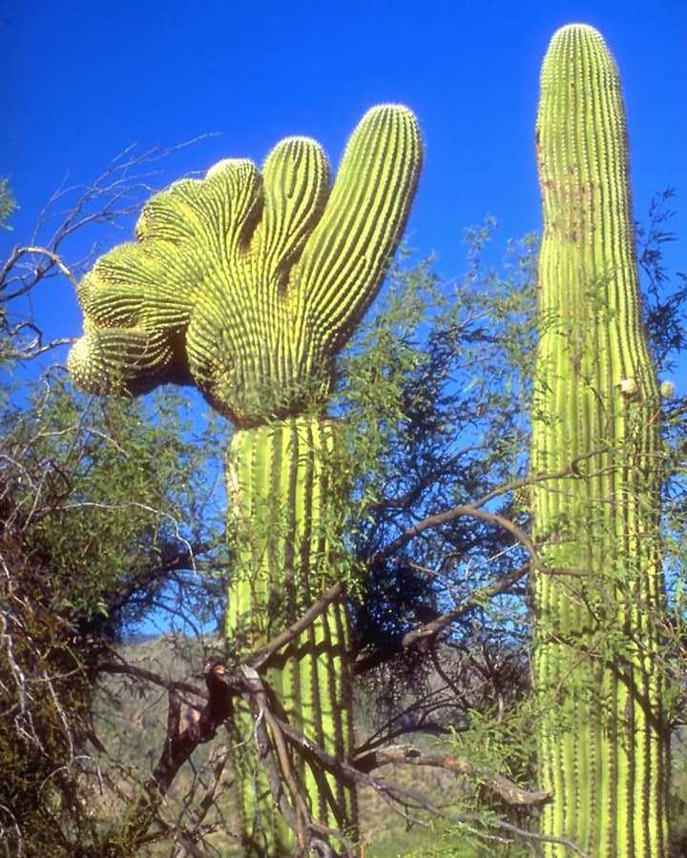
Questions?

